Slide 1
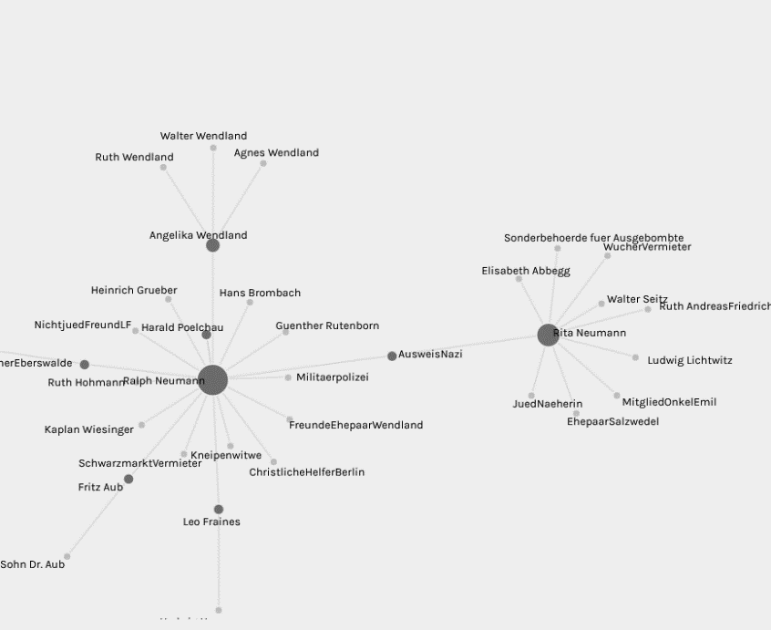
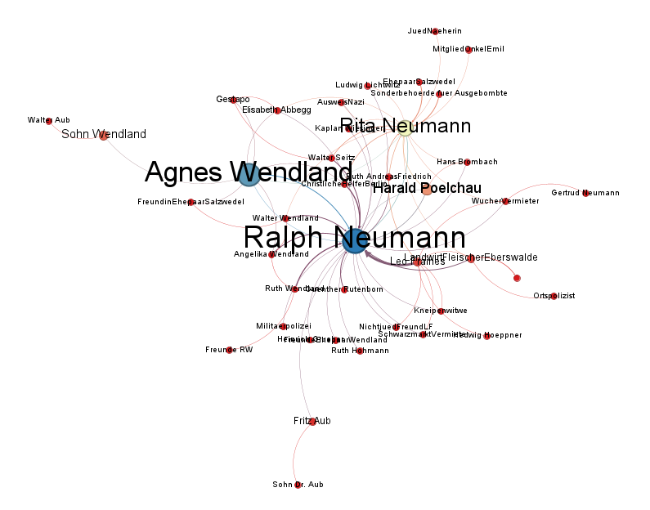
Network Analysis with Palladio and Gephi
By Paul Heaton, The University of Reading
Objectives: This short tutorial is an introduction to network analysis
software. It is not exhaustive, but aims to give the user a basis upon
which to take the subject further with their own analysis.
Outputs from Palladio and Gephi for Ralph Neumann donor relationships

Slide 2
Software
Palladio is an online resource into which a data set can be loaded.
Palladio offers a relatively easy setup but is limited in respect to colours and functionality.
Palladio is useful for quick analysis of datasets in terms of relationships.
Gephi is a downloadable free application which and can take a variety of data file types.
Gephi offers a high degree of functionality and customisation in terms of colours and graphical output.
Gephi can be difficult to set up and requires a good degree of knowledge in using to get the best out of it.

Slide 3
Software capabilties
Network analysis is concerned with the relationships between sets of data.
Both Palladio and Gephi can take data in the form of a .csv file
Both Palladio and Gephi both use two data files which are called nodes and edges.
Nodes define the subject(s) of the data.
Edges define the relationships to or between the subject(s).

Slide 4
Data sources
For this tutorial we will be using the data source provided by
https://programminghistorian.org
The data sets for nodes are here:
https://programminghistorian.org/assets/creating-network-diagrams-from-historical-sources/network-example2-en.csv
Or https://rsehosting.reading.ac.uk/courses/network_analysis/data/nodes-palladio.csv
And the data set for edges are here:
https://programminghistorian.org/assets/creating-network-diagrams-from-historical-sources/network-example1-en.csv
Or https://rsehosting.reading.ac.uk/courses/network_analysis/data/edges-palladio.csv
This data set explores the relationship between donors and recipients of help during the Holocaust, based on the diaries of Ralph Neumann.

Slide 5
Palladio
Web application:
https://hdlab.stanford.edu/palladio-app/#/upload

Slide 6
Nodes preparation - Palladio
The nodes dataset: here we have the subject donors with their
Race Status and Gender:
Ludwig Lichtwitz,99,99
Ralph Neumann,2,1
Rita Neumann,2,2
Notice that Race and Gender have been Tokenised.
Here the author has assigned 99 as Unknown, Male gender as 1,
and Female gender as 2.
Race Status has been similarly tokenised.

Slide 7
Edges preparation - Palladio
The edges dataset: here we have the subject donors with their
Race Status and Gender:
Giver,Recipient,Form of Help,Relation,Date of Activity,…
MitgliedOnkelEmil,Rita Neumann,3,2,15,…
Here we see the relationships between the different people listed in the
Nodes file. In the extract above MitgliedOnkelEmil donated to
Rita Neumann.
As with the Nodes dataset, other parameters such as Form of Help and relation have been tokenised. Palladio can understand dates and Geospacial data so these would not necessarily need to be tokenised.
.

Slide 8
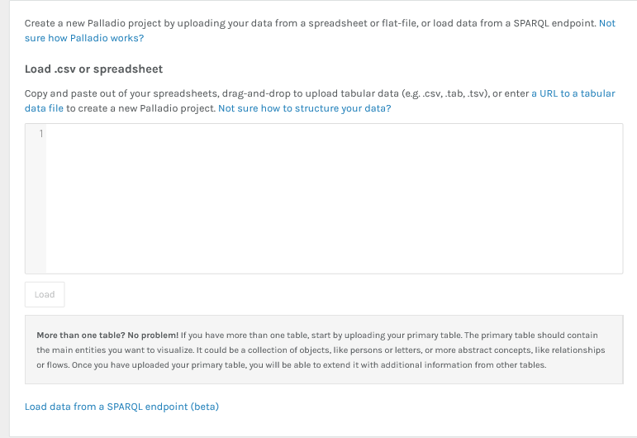
Loading the Data- Palladio
The initial data is loaded into Palladio via the load window located at:
https://hdlab.stanford.edu/palladio-app/#/upload
Files are dragged and dropped into the load window
and the results are displayed in the pane. Clicking the `Load` button
starts the project.

Slide 9
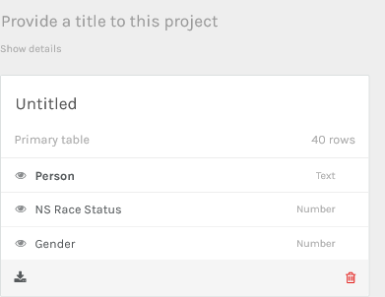
Visualising the data- Palladio
Navigate to the page:
https://hdlab.stanford.edu/palladio-app/#/upload
Rename the file network-example2-en.csv to nodes-palladio.csv
Drag and drop the Nodes dataset into the upload window and click ‘Load‘.
You should see a summary of the
Data fields and the data type that
Palladio thinks it is.
This is the primary Nodes table.
Provide a title for the
project and name the table `People`
by Clicking on the relevant area.

Slide 10
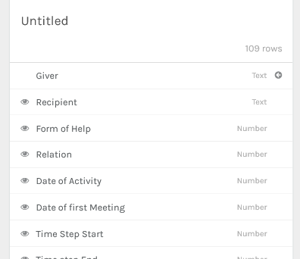
Visualising the data- Palladio
The next stage is to add the Edges table
Rename the file network-example1-en.csv to edges-palladio.csv
Click on `Person` and you will see a summary of the Nodes table.
Now click on `Add a new table` in the bottom right of this panel and
Drag and drop the edges-palladio.csv file into the window and click `load`.
You should see a summary of the
Data fields and the data type for the
Edges table.
Click done to see the table in the
Main window
Provide a title for the
new table by clicking on the
Untitled area and call it `Relations`.

Slide 11
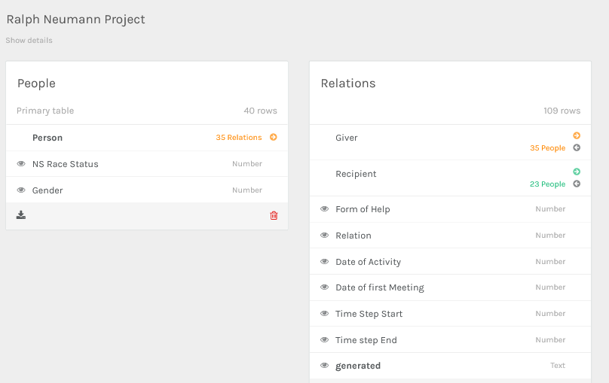
Visualising the data- Palladio
You should now have two tables which look like the figure below,
showing 35 matches between the Givers and 23 people as Recipients.

Slide 12
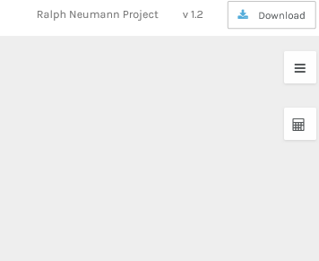
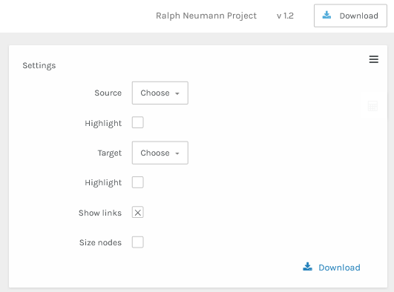
Visualising the data- Palladio
The data is now ready to by graphed. Click on `Graph` from the main
Window, then click on the button in the top right hand corner.
Here we explicitly tell Palladio which variables we want to plot.

Slide 13
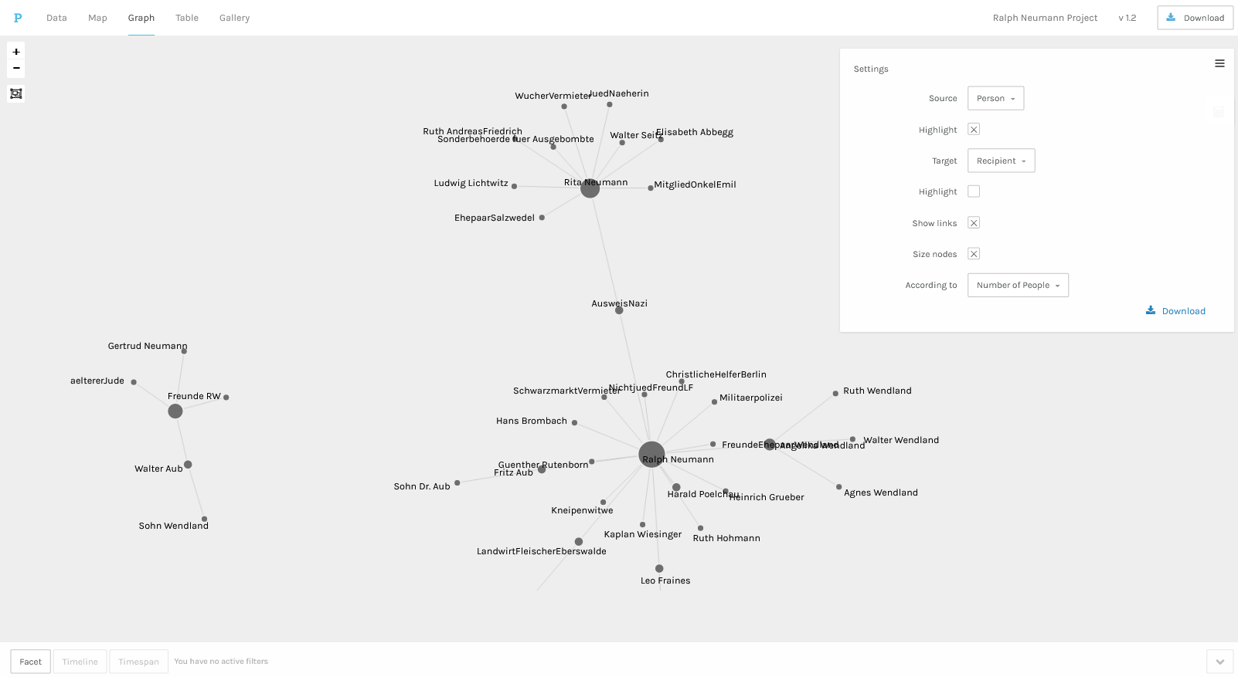
Visualising the data- Palladio
Select `Source` as Person and `Target` as Recipient, and tick the
optional boxes. You should now see a diagram as below.

Slide 14
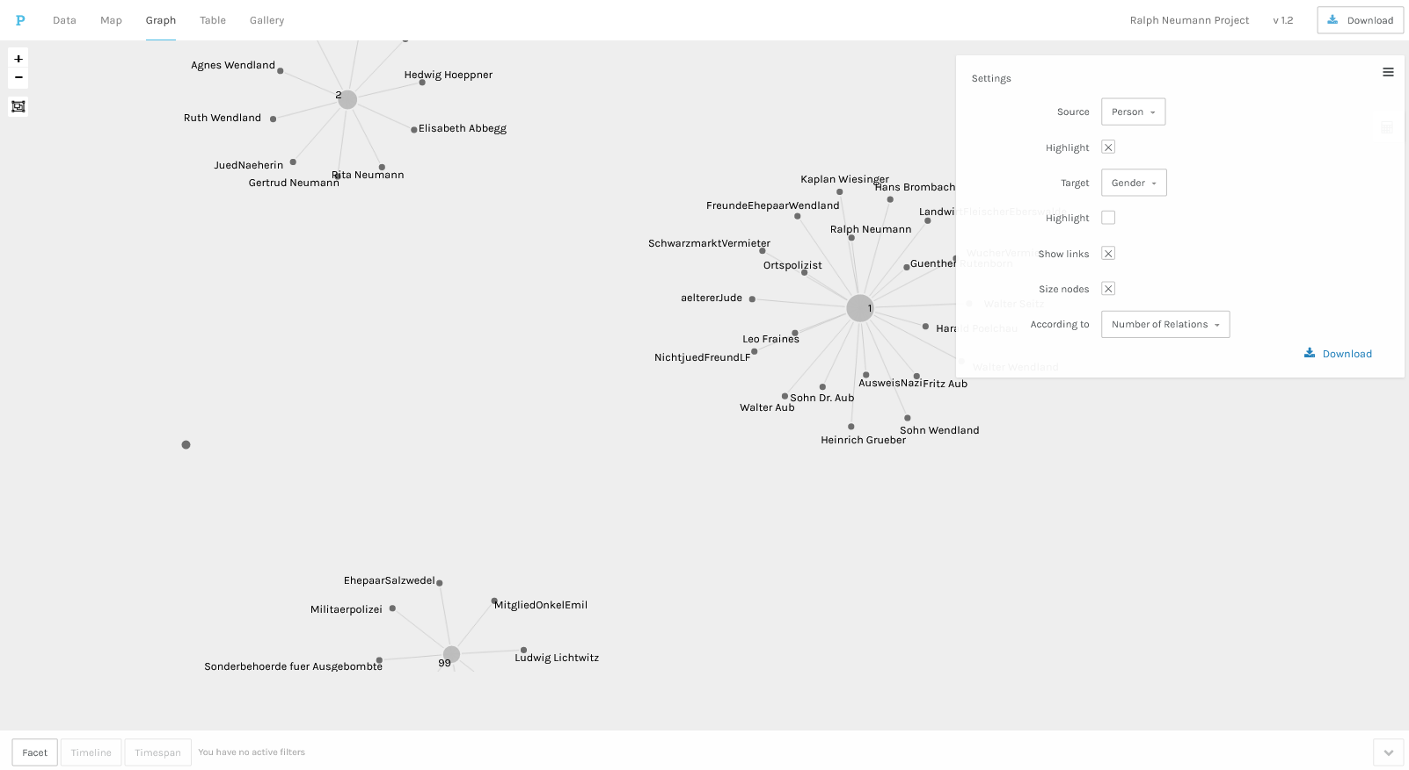
Visualising the data- Palladio
By selecting different sources and targets, the data can be viewed in
different ways according to relationship. The image below shows the
relationships by gender.

Slide 15
Gephi
Install package:
https://gephi.org/users/download/

Slide 16
Data preparation - Gephi
Gephi is a far more complex piece of software than Palladio, but it does
offer a wide variety of options in terms of display and analysis.
Here we will use the same dataset as for Palladio, but demonstrate the
differences in data preparation in order to get a similar network diagram.
One of the key differences between the two softwares is that Gephi uses
Id’s as key fields to bind the relationships together.
The other key difference is that Gephi requires the user to carry out
operations on the data in order to allow the network to be customised.
In other words, Gephi does not make assumptions about the data in the
Way that Palladio does.

Slide 17
Node preparation - Gephi
The first stage in preparing data for use by Gephi is to assign an Id to
the donors and recipients in the nodes dataset we used for Palladio.
In Palladio we have:
Person,NS Race Status,Gender
Ludwig Lichtwitz,99,99
Ralph Neumann,2,1
Rita Neumann,2,2…
For Gephi, we add a new column `Id` to the dataset, and change the
`Person` header to `Label`:
Id,Label,NS Race Status,Gender
1,Ludwig Lichtwitz,99,99
2,Ralph Neumann,2,1
3,Rita Neumann,2,2…
A prepared node file is available at nodes-gephi.csv

Slide 18
Edge preparation - Gephi
Gephi uses Id as the connection between nodes and it must have fields
called Source and Target to operate.
In our example Source is id of the source of help (the Giver), and Target is the
id of the recipient of the help (the Person field in the Palladio dataset).
So we need to amend the Edges dataset to reflect this viz:
In Palladio we have:
Giver,Recipient,Form of Help,Relation,Date of Activity,Date of First Meet…
MitgliedOnkelEmil,Rita Neumann,3,2,15,…
Leo Fraines,Ralph Neumann,4,6,12,…
Walter Seitz,Ruth Hohmann,2,4,15,15,15,16 …
For Gephi, `Giver` becomes `Source` and `Recipient` becomes `Target`:
Id,Source,Target,Form of Help,Relation,Date of Activity,Date of first Meeting,…
33,3,Directed,1,3,2,…
4,2,Directed,1,4,6,12,…
A prepared edges file is available at edges-gephi.csv

Slide 19
Importing data- Gephi
Run the Gephi application and select New project from the file menu.
Now select `Dat Laboratory` tab.
Click on `Node` and `Import Spreadsheet` and select `nodes-gephi.csv`.
At the dialog, select delimiter as `comma` and `Apply`.
At the next dialog select `Add to existing Workspace`
Next select the Edges button and `Import spreadsheet` and select
`edges-gephi.csv`.
At the dialog, separator as `comma` and and `Edges Table`
from the `Import As` option. Click `Next`
At the next dialog change `string` to `integer` and click `Finish`.

Slide 20
Processing data- Gephi
You should now have two tables in the Data Laboratory representing
Nodes and Edges
.
Now click on the button marked `Overview` and you should see the basic
Network but rather small. So the first operation to perform is to scale the
diagram.
Now find the tab marked `Layout` and select `Force Atlas` from the
Dropdown. Find `Repulsion strength` and set it to 40000, and click `Run`.
The network will expand and when steady click `Stop`.
Next find `Average Path Length` under `Edge Overview` in the
Statistics tab on the right hand side and click `Run`.
Metrics now be calculated and shown in dialogs and figures added to the
Edges data table in the `Data Laboratory` for use later.

Slide 21
Processing data- Gephi
Now return to the `Overview` screen and locate `Ranking` for nodes.
From the drop-down select `Betweeness Centrality` and below that on the
far right of `Color` click the small icon, go to `Default` and pick the bottom
option for colour range.
Now select `Degree` under `Ranking` tab and click the concentric circles
Icon. You should see a Min and Max size options. Set these to 20 and 50
Respectively, and click apply.
The diagram will now change to show coloured circles according to
number of connections with arrows showing which way the help was given.
Finally, go back to `Force Atlas` layout and tick the `Adjust by sizes` box
and re-run the layout. Click `Stop` when stable.

Slide 22
Filtering data- Gephi
Gephi offers many ways to filter your data. Filters are to be found on the
right hand side of the screen under the `Filters` tab.
Here we will look at one to show the principle.
Open the `Topology` menu under the `Filters` tab. Find `Degree Range` and
drag the `Degree Range` filter into the section below marked `Queries`.
You will now see a slider appear with a bar chart below.
By adjusting the slider and clicking the `Filter` button you will see nodes
disappearing. The further to the right the slider is place more and more
less important nodes are hidden.
To remove the filter, right click on the filter in the `Queries` box and click
`Remove`.

Slide 23
Configuring labels - Gephi
Labels in Gephi are toggled on and off using the large black `T` on the
menu at the bottom of the screen.
Click on the `T` to reveal the names associated with the nodes.
The labels can be formatted using the slider and buttons on the
bottom menu and using the buttons `A` and `Tt` under the `Appearance`
panel on the top right of the screen.
The diagram is now ready for the final presentation.
Click on the `Preview` button just under the main menu and you will now
see the final diagram with curved edge lines and proportionally sized
labels.
On the left hand side is a new menu which allow fine tuning of the
appearance. When changing the values here always click `Refresh` to
see the result.

Slide 24
Saving your project - Gephi
Once you are happy with the appearance of your network diagram you
have the option to save the project for future use and generate an image
of the network by clicking on `Export SVG/PDF/PNG` in the bottom left
hand corner of the preview screen.
The final diagram should look something like this:

